Slide 1

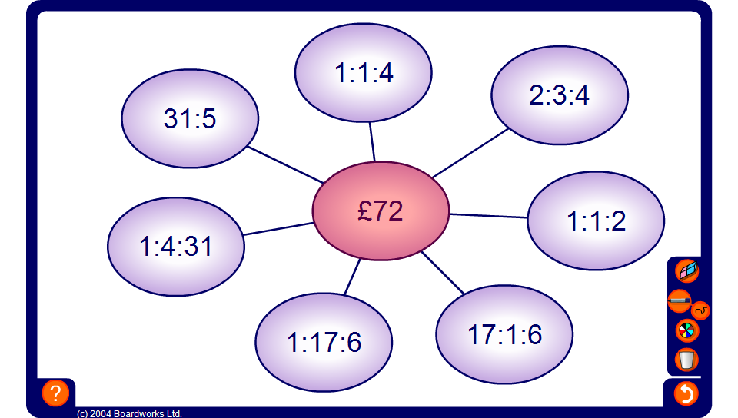


Dividing in a given ratio spider diagram
Notes:
The object of this activity is to divide the amount in the centre into each of the given ratios.

